Slide 1
ARM ARCHITECTURE
PRESENTED BY SAI VIVEK.S

Slide 2
Contents
ARM history.
About Arm.
Arm is RISC.
ARM processor state.
ARM Architecture.
ARM registers.
Processor modes.
Exception handling.
Vector table.
Pipelining.
Advantages and Disadvantages.
ARM vs X86.
Reference.

Slide 3
ARM history
1985: Acorn Computer Group manufactures the first commercial RISC microprocessor.
1990: Acorn and Apple participation leads to the founding of Advanced RISC Machines (A.R.M.).
1991: ARM6, First embeddable RICS microprocessor.
1992-1994: Various companies use ARM (Sharp, Samsung), while in 1993 ARM7, the first multimedia microprocessor is introduced.
1995: Introduction of Thumb and ARM8.
1996-2000: Alcatel, Hyundai, Philips, Sony, use ARM, while in 1999 η ARM cooperates with Erickson for the development of Bluetooth.
2000-2002: ARM's share of the 32-bit embedded RISC microprocessor market is 80%. ARM Developer Suite is introduced.

Slide 4
About ARM
ARM stands for Advanced RISC Machine.
It is a simple RICS-based architecture with powerful design.
A whole family of ARM processors exist.
  Shares similar design principles and a common instruction set.
Design philosophy:
  Small processor for lower power consumption.
  High code density for limited memory and physical size restrictions.
  Can interface with slow and low-cost memory systems.
  Reduced die size for processor to accommodate more peripherals.
ARM doesn’t manufacture or sell any chips directly.

Slide 5
Arm is RISC
RISC supports simple but powerful instructions that executes in a single cycle at high clock frequency.
Major design feature:
  Instruction : reduced set/single cycle/fixed length.
  Pipeline : decode in one stage/no need for microcode.
  Registers : a large set of general-purpose registers.
  Load/store architecture : data processing instructions apply to registers only ; load/store to transfer data from memory.
Results in simple design and fast clock rate.
Now-a-days CISC machine also implement RISC concepts.

Slide 6
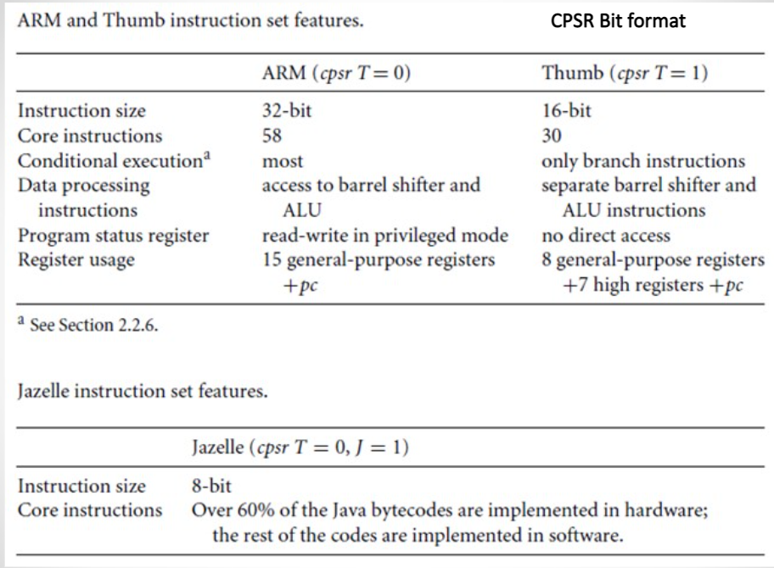
ARM Processor States
The state of the core determines which instruction set is being executed. There are three instruction sets: ARM, Thumb, and Jazelle.
The ARM instruction set is only active when the processor is in ARM state. Similarly the Thumb instruction set is only active when the processor is in Thumb state. Once in Thumb state the processor is executing purely Thumb 16-bit instructions. You cannot intermingle sequential ARM, Thumb, and Jazelle instructions.
The ARM designers introduced a third instruction set called Jazelle. Jazelle executes 8-bit instructions and is a hybrid mix of software and hardware designed to speed up the execution of Java byte codes.
The Jazelle J and Thumb T bits in the cpsr reflect the state of the processor. When both J and T bits are 0, the processor is in ARM state and executes ARM instructions. This is the case when power is applied to the processor. When the T bit is 1, then the processor is in Thumb state. To change states the core executes a specialized branch instruction. Table 2 compares the ARM and Thumb instruction set features.

Slide 7
What is ARM architecture ?
The software architecture of a system represents the design decisions related to overall system structure and behavior. Architecture helps stakeholders understand and analyze how the system will achieve essential qualities such as modifiability, availability, and security.
The architecture can be divided into A, R, and M profiles.
‘A’ profile is mainly for applications, ‘R’ profile is for real-time and
‘M’ profile is for Microcontroller.
‘A’ profile helps to maintain high performance and is designed to run the complex system in Linux or Windows.
‘R’ profile checks for systems with real-time requirements and is found in networking equipment or embedded control systems.
‘M’ profile is used in IoT devices and can be synchronized with small and high-power devices

Slide 8
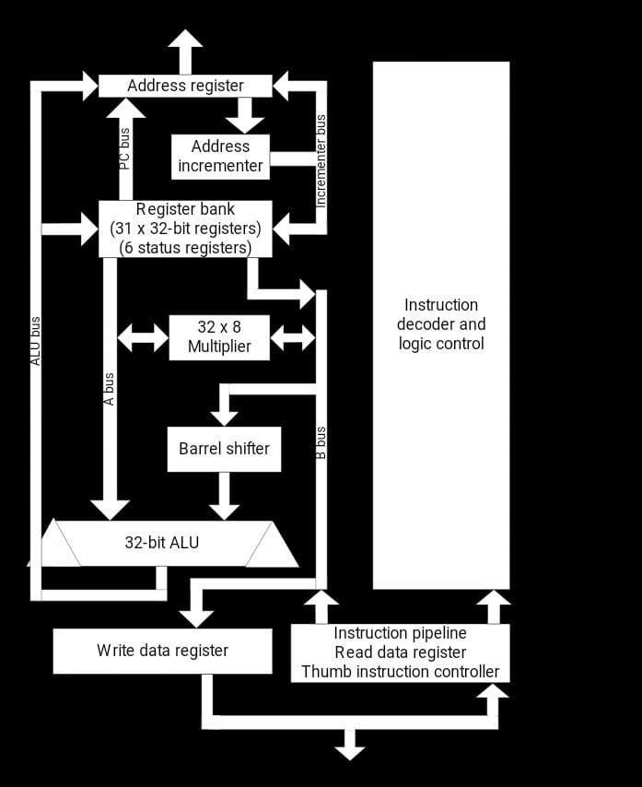
ARM architecture

Slide 9
Cont…
An ARM core as functional units connected by data buses.
Data enters the processor core through the Data bus. The data may be an instruction to execute or a data item.
In VON NEUMANN implementation of the ARM –data items and instructions share the same bus. In contrast HARVARD implementation of the ARM use two different buses.
The instruction decoder translates instructions before they are executed. Each instruction executed belongs to a particular instruction set.
The ARM processor, like all RISC processors, uses a load-store architecture. This means it has two instruction types for transferring data in and out of the processor: load instructions copy data from memory to registers in the core, and conversely the store instructions copy data from registers to memory. There are no data processing instructions that directly manipulate data in memory. Thus, data processing is carried out solely in registers.

Slide 10
Cont…
Data items are placed in the register file-a storage bank made up of 32-bit registers. Since the ARM core is a 32-bit processor, most instructions treat the registers as holding signed or unsigned 32-bit values.
The sign extend hardware converts signed 8-bit and 16-bit numbers to 32-bit values as they are read from memory and placed in a register.
ARM instructions typically have two source registers, Rn and Rm, and a single result or destination register, Rd. Source operands are read from the register file using the internal buses A and B, respectively.
The ALU (arithmetic logic unit) or MAC (multiply-accumulate unit) takes the register values Rn and Rm from the A and B buses and computes a result. Data processing instructions write the result in Rd directly to the register file. Load and store instructions use the ALU to generate an address to be held in the address register and broadcast on the Address bus.
One important feature of the ARM is that register Rm alternatively can be preprocessed in the barrel shifter before it enters the ALU. Together the barrel shifter and ALU can calculate a wide range of expressions and addresses. After passing through the functional units, the result in Rd is written back to the register file using the Result bus.
For load and store instructions the incrementer updates the address register before the core reads or writes the next register value from or to the next sequential memory location.
The processor continues executing instructions until an exception or interrupt changes the normal execution flow.

Slide 11
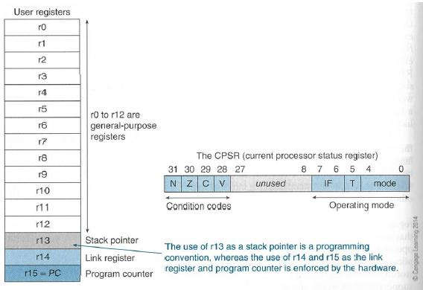
ARM Registers
  General-purpose registers hold either data or an address.
  The active registers available in user mode-a protected mode normally used when executing applications.
  The ARM processor has three registers assigned to a particular task or special function: r13, r14, and r15.
  They are frequently given different labels to differentiate them from the other registers.
  Register r13 is traditionally used as the stack pointer (sp) and stores the head of the stack in the current processor mode.
  Register r14 is called the link register (Ir) and is where the core puts the return address whenever it calls a subroutine.
  Register r15 is the program counter (pc) and contains the address of the next instruction to be fetched by the processor.

Slide 12
Cont…
The processor can operate in seven different modes. All the registers shown are 32 bits in size.
There are up to 18 active registers: 16 data registers and 2 processor status registers. The data registers are visible to the programmer as r0 to r15.
Depending upon the context, registers r13 and r14 can also be used as general-purpose registers, which can be particularly useful since these registers are banked during a processor mode change.
In ARM state the registers r0 to r13 are orthogonal-any instruction that you can apply to r0 you can equally well apply to any of the other registers. However, there are instructions that treat r14 and r15 in a special way.
In addition to the 16 data registers, there are two program status registers: CPSR and SPSR (the current and saved program status registers, respectively).
Interrupt mask
Interrupt masks are used to stop specific interrupt requests from interrupting the processor.
There are two interrupt request levels available on the ARM processor core-interrupt request (IRQ) and fast interrupt request (FIQ).

Slide 13
Cont…
The cpsr has two interrupt mask bits, 7 and 6 (or / and F), which control the masking of IRQ and FIQ, respectively.
The / bit masks IRQ when set to binary 1, and similarly the F bit masks FIQ when set to binary 1(disable).
Conditional flags
Conditional flags are updated based on the result of ALU operations.
V (overflow flag) is set when result causes signed overflow.
C (carry flag) is set when result cause any unsigned carry.
Z (zero flag) is set when result is zero, frequently used to indicate the equality.
N (negative flag) is set when the result is negative.

Slide 14
Processor Modes
First 5 bits are signifies as mode selection.
The processor mode determines which registers are active and the access rights to the CPSR register itself.
Each processor mode is either privileged or nonprivileged: A privileged mode allows full read-write access to the CPSR. Conversely, a nonprivileged mode only allows read access to the control field in the CPSR but still allows read-write access to the condition flags.
There are seven processor modes in total: six privileged modes (abort, fast interrupt request, interrupt request, supervisor, system, and undefined) and one nonprivileged mode (user).
As we know there are 37 registers in the register file. Of those, 20 registers are hidden from a program at different times. These registers are called banked registers and they are available only when the processor is in a particular mode.

Slide 15
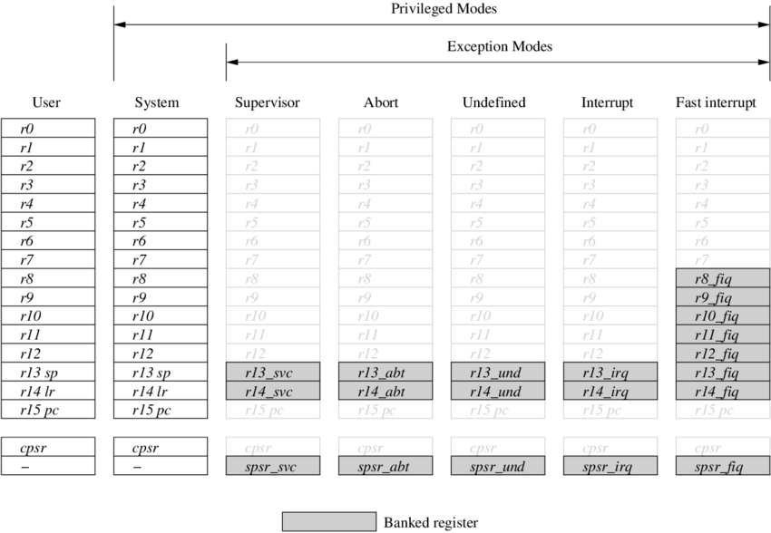

Slide 16
Cont…
The processor mode can be changed by a program that writes directly to the cpsr (the processor core has to be in privileged mode) or by hardware when the core responds to an exception or interrupt.
The following exceptions and interrupts cause a mode change: reset, interrupt request, fast interrupt request, software interrupt, data abort, prefetch abort, and undefined instruction.
Exceptions and interrupts suspend the normal execution of sequential instructions and jump to a specific location.
Whenever an interrupt is raised the core changes from user mode to interrupt request mode. This cause r13 and r14 to be banked. The user registers are replaced with r13_irq and r14_irq, where r14_irq contains return address and r13 contains stack pointer for interrupt request mode.
A new register also appears in interrupt request mode: the saved program status register (spsr), which stores the previous mode's cpsr. You can see in the diagram the cpsr being copied into spsr_irq.
To return back to user mode, a special return instruction is used that instructs the core to restore the original cpsr from the spsr_irq and bank in the user registers r13 and r14. Note that the spsr can only be modified and read in a privileged mode. There is no spsr available in user mode.

Slide 17
Exception handling
Our ARM handles exceptions by making use of the banked registers to save state. The old PC and CPSR contents are copied into the appropriate R14 and SPSR and the PC and mode bits in the CPSR bits are forced to a value that depends on the exception.
Interrupt disable flags are set where required unmanageable nesting's of exceptions.
In the case of a re-entrant interrupt handler, R14 and the SPSR should be saved onto a stack in main memory before re-enabling the interrupt; when transferring the SPSR register to and from a stack, it is important to transfer the whole 32-bit value, and not just the flag or control fields.
When multiple exceptions arise simultaneously, a fixed priority determines the order in which they are handled.

Slide 18
Vector Table
When an exception or interrupt occurs, the processor sets the pc to a specific memory address. The address is within a special address range called the vector table. The entries in the vector table are instructions that branch to specific routines designed to handle a particular exception or interrupt.
The memory map address 0x00000000 is reserved for the vector table, a set of 32-bit words. On some processors the vector table can be optionally located at a higher address in memory (starting at the offset Oxffff0000).
When an exception or interrupt occurs, the processor suspends normal execution and starts loading instructions from the exception vector table

Slide 19
Cont…
Each vector table entry contains a form of branch instruction pointing to the start of a specific routine:
Reset vector is the location of the first instruction executed by the processor when power is applied. This instruction branches to the initialization code.
Undefined instruction vector is used when the processor cannot decode an instruction.
Software interrupt vector is called when you execute a SWI instruction. The SWI instruction is frequently used as the mechanism to invoke an operating system routine.
Pre-fetch abort vector occurs when the processor attempts to fetch an instruction from an address without the correct access permissions. The actual abort occurs in the decode stage.
Data abort vector is similar to a prefetch abort but is raised when an instruction attempts to access data memory without the correct access permissions.
Interrupt request vector is used by external hardware to interrupt the normal execution flow of the processor. It can only be raised if IRQs are not masked in the cpsr.
Fast interrupt request vector is similar to the interrupt request but is reserved for hardware requiring faster response times. It can only be raised if FIQs are not masked in the cpsr.

Slide 20
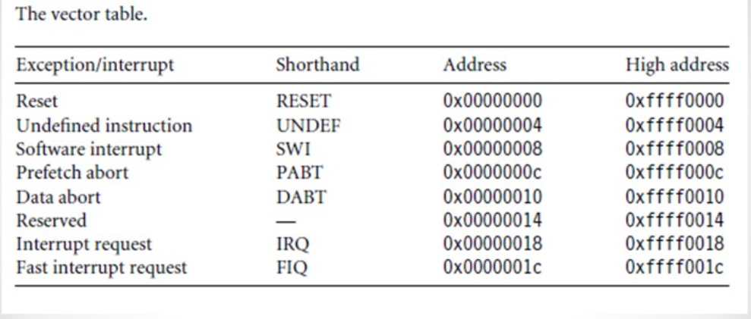
Cont…
Priority Order:
RESET(Highest priority).
Data Abort.
FIQ.
IRQ.
Pre-fetch Abort.
SWI, undefined instruction.

Slide 21
Pipelining
Mechanism to speed up the regular execution by fetching the next instruction while the present instruction is being decoded and executed.
Induces Parallelism- executing several instructions at a time.
Pipelining (Temporal Parallelism) should ideally increase throughput without any penalty in latency.
Pipelining divides the instruction cycle into multiple stages:
Fetch→ Decode → Execute → Memory operations
Disadvantage: If the level of pipelining is increased and the instruction spends more time in the pipeline, data dependencies start to surface.

Slide 22
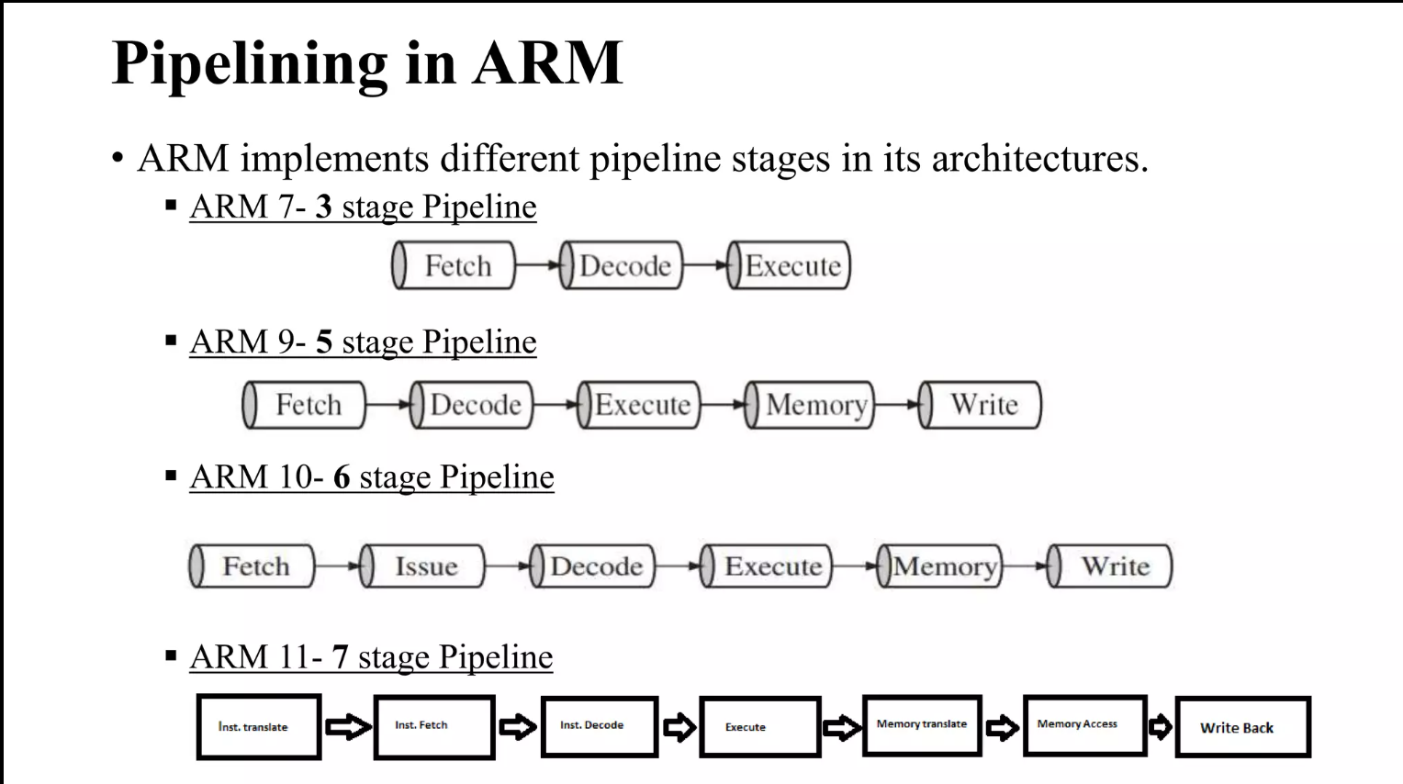

Slide 23
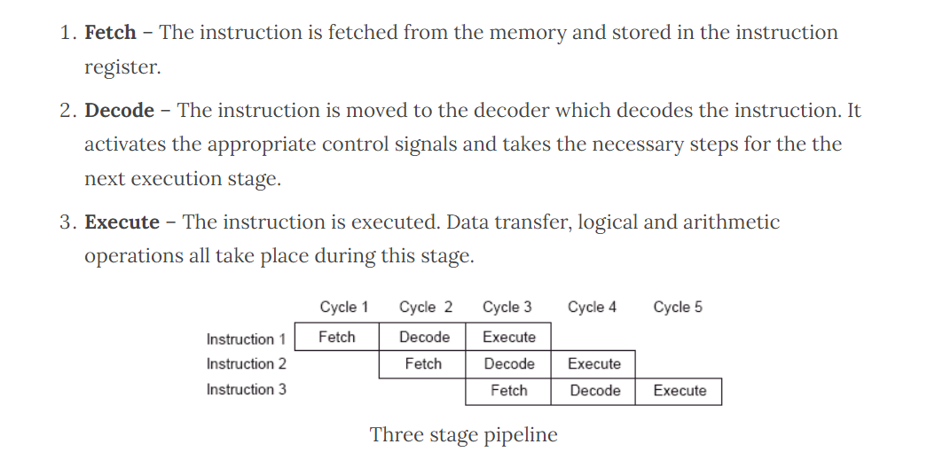
Three Stage pipelining

Slide 24
Advantages and Disadvantages
Advantages:
It is very affordable as it does not need expensive equipment’s for its creation.
It have lesser power consumption.
It performs single operation at a time. This makes it work faster. It has lower latency that is quicker response time.
The processor uses load store architecture that stores data in various registers (to reduce memory interactions). It has separate load and store instructions that are used to transfer data between external memory and register bank.
ARM processors have simple circuits, hence they are very compact and can be used in devices that are smaller in size (several devices are becoming smaller and more compact due to customer demands).
It have better battery life.
Disadvantages:
It is not compatible with X86 hence it cannot be used in Windows.
The speeds are limited in some processors which might create problems.
Scheduling instructions is difficult in case of ARM processors.
There must be proper execution of instructions by programmer. This is because entire performance of ARM processors depend upon their execution.
ARM Processor needs very highly skilled programmers. This is because of importance and complexity of execution (processor shows lesser performance when not executed properly).

Slide 25
ARM vs X86
ARM
X86
Uses Reduced Instruction Set computing Architecture (RISC).
Executes single instruction per cycle.
Optimization of performance with Software focused approach.
Requires less registers, more memory.
Pipelining of instructions is a unique feature.
Faster Execution of Instructions reduces time.
Complex addressing is managed by software.
Compiler plays a key role in managing operations.
Multiple Instructions are generated from a complex one and executed individually.
Uses Complex Instruction Set computing Architecture (CISC).
Executes complex instruction at a time, and it takes more than a cycle.
Hardware approach to optimize performance.
It uses more registers and less memory
Less pipelined.
Time to execute is more.
Inherently designed to handle complex addresses.
The micro program does the trick.
Its Architecture is capable of managing complex statement execution at a time.

Slide 26
Cont…
ARM
X86
Managing code expansion is difficult.
Decoding of instruction is handled easily
Uses available memory for calculations.
Deployed in mobile devices where size, power consumption speed matters.
Code expansion is managed easily.
Decoding is handled in a complex way.
Needs supplement memory for calculations
Deployed in Servers, Desktops, Laptops where high performance and stability matters.

Slide 27
References
nptel.com
educba.com
Redhat.com
geeksforgeeks

Slide 28
Any Queries ?

Slide 29
Thank You

